Slide 1
ANCIENT INDIAN ARCHITECTURE AND INNOVATIONS
By
Dev Shakya and Shorya Tyagi

Slide 2
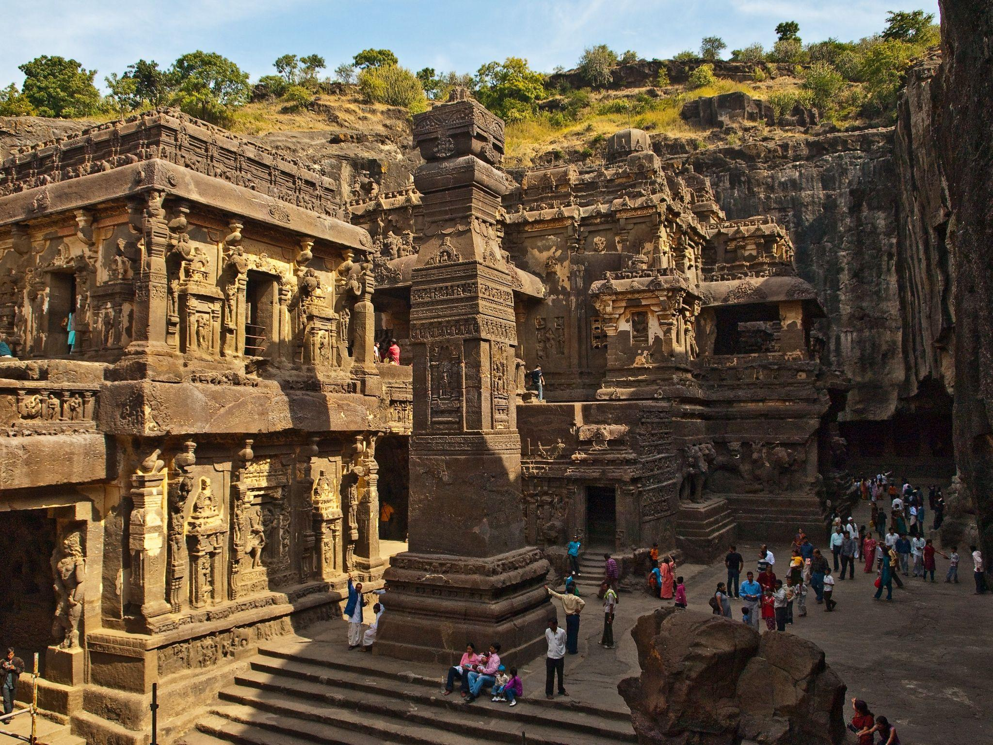
★ KAILASA TEMPLE, ELLORA
The Kailasa temple (Cave 16) is the largest of the 34 Buddhist, Jain and Hindu cave temples and monasteries known collectively as the Ellora Caves, ranging for over two kilometres (1.2 mi) along the sloping basalt cliff at the site.[5] Most of the excavation of the temple is generally attributed to the eighth century Rashtrakuta king Krishna I (r. c. 756 – 773)

Slide 3
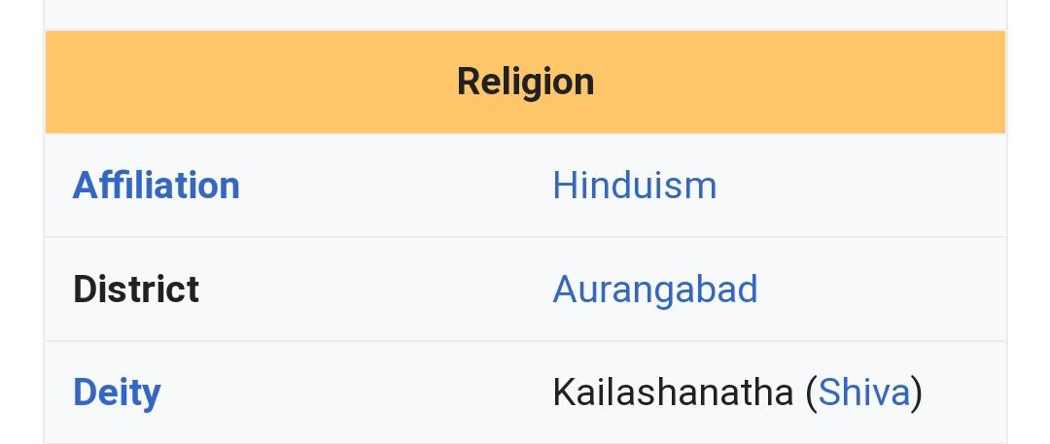
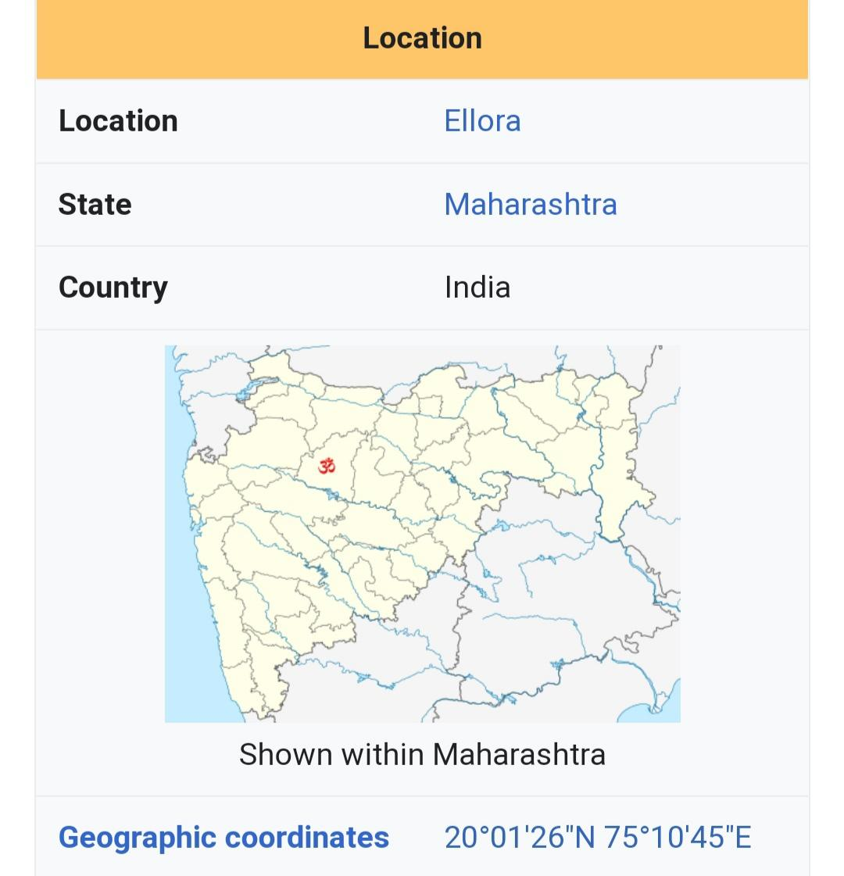
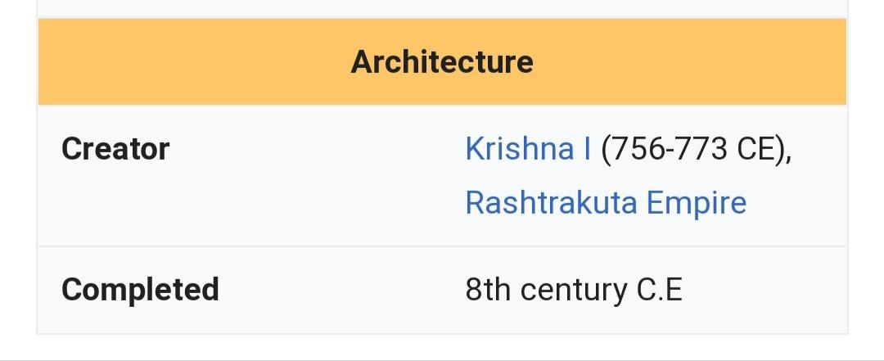

Slide 4
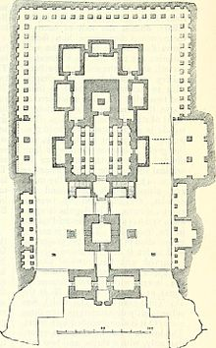
it is considered one of the most remarkable cave temples in the world because of its size, architecture and sculptural treatment, and "the climax of the rock-cut phase of Indian architecture".
The top of the superstructure over the sanctuary is 32.6 metres (107 ft) above the level of the court below, although the rock face slopes downwards from the rear of the temple to the front. Archaeologists believe it is made from a single rock.
Ground Plan of Temple

Slide 5
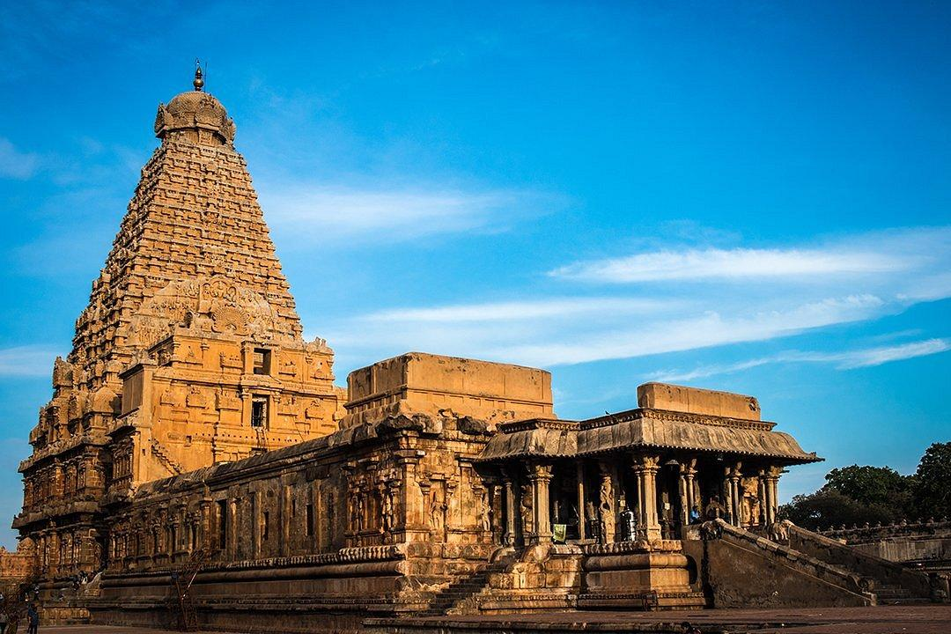
★ Brihadisvara Temple, Thanjavur
Brihadishvara Temple (originally known as Peruvudaiyar Kovil) locally known as Thanjai Periya Kovil, and also called Rajarajeswaram, is a Hindu Dravidian styled temple dedicated to the god Shiva located in South bank of Cauvery river in Thanjavur, Tamil Nadu, India.Built by Chola emperor Rajaraja I between 1003 and 1010 CE, the temple is a part of the UNESCO World Heritage Site known as the "Great Living Chola Temples", along with the Chola dynasty era Gangaikonda Cholapuram temple and Airavatesvara temple that is about 70 kilometres (43 mi) and 40 kilometres (25 mi) to its northeast respectively.

Slide 6
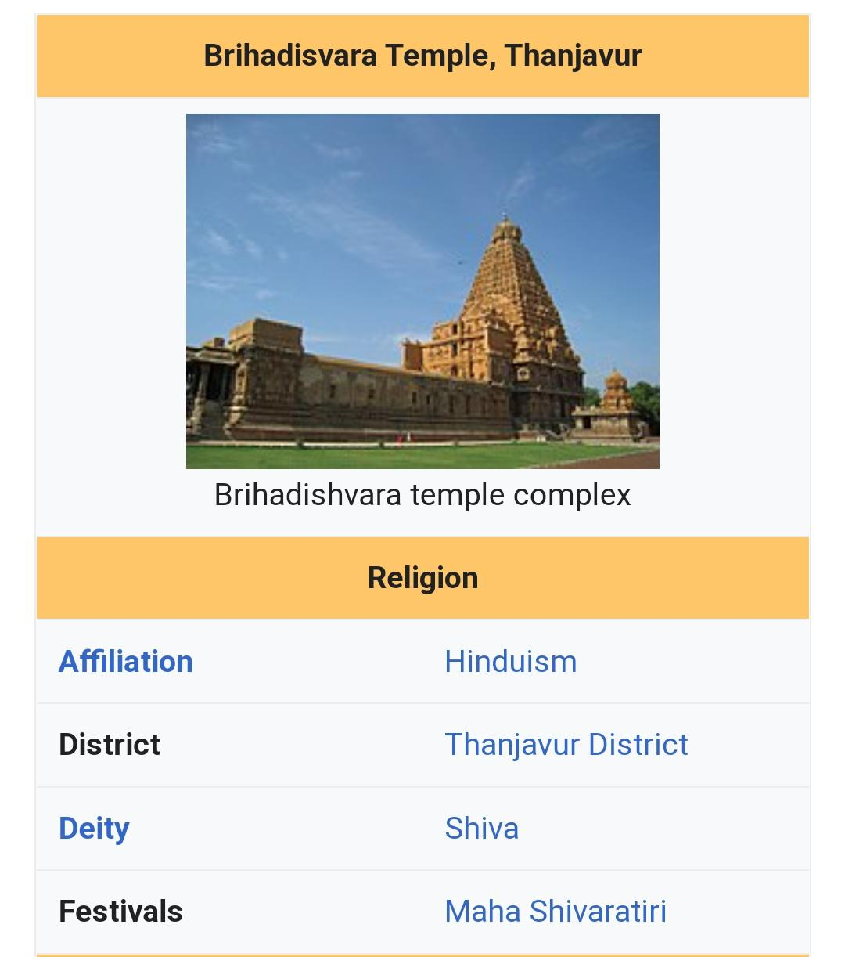
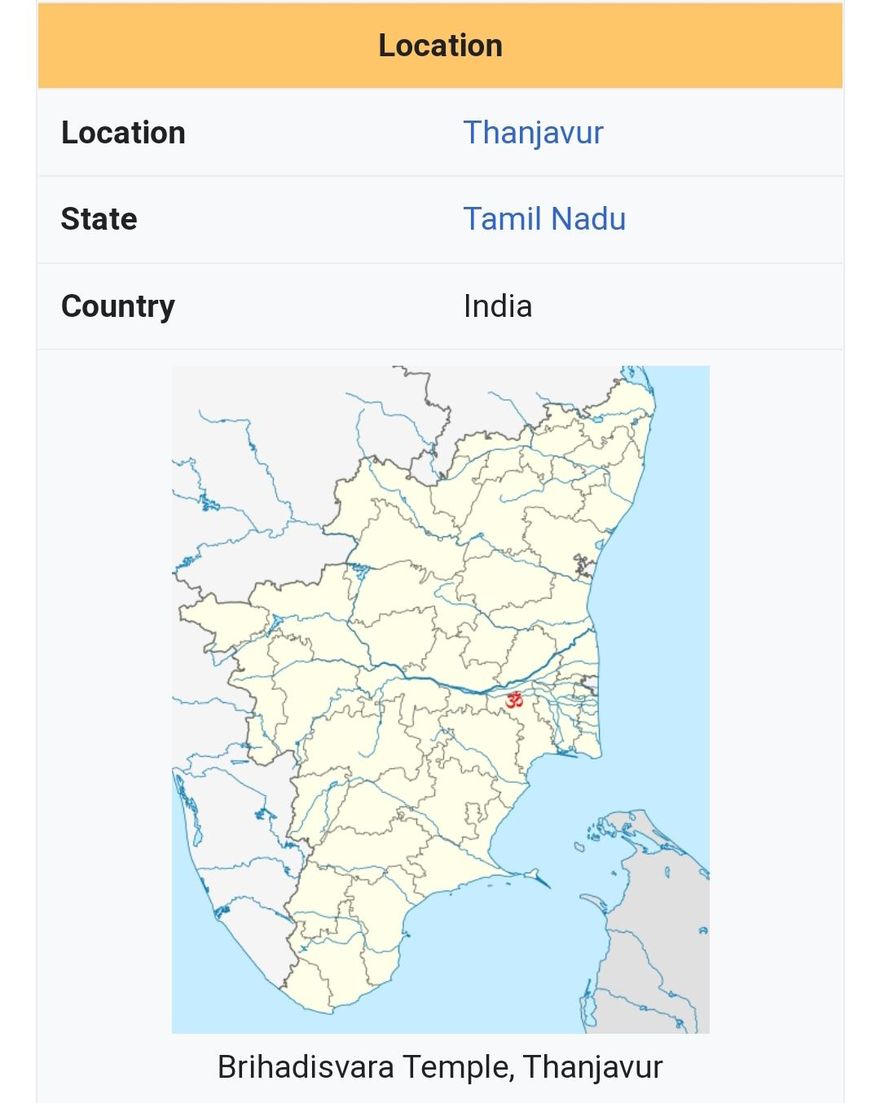

Slide 7
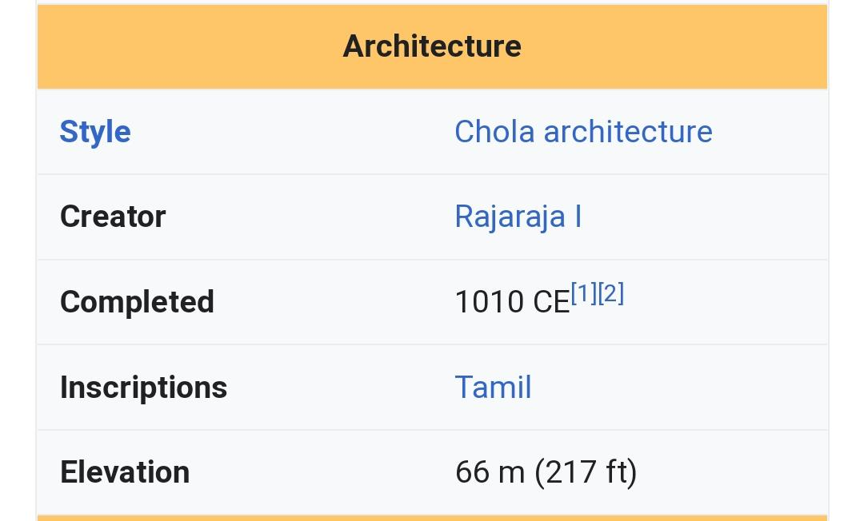
It is one of the largest Hindu temples and an exemplary example of a fully realized Tamil architecture. It is called as Dakshina Meru (Meru of south).

Slide 8
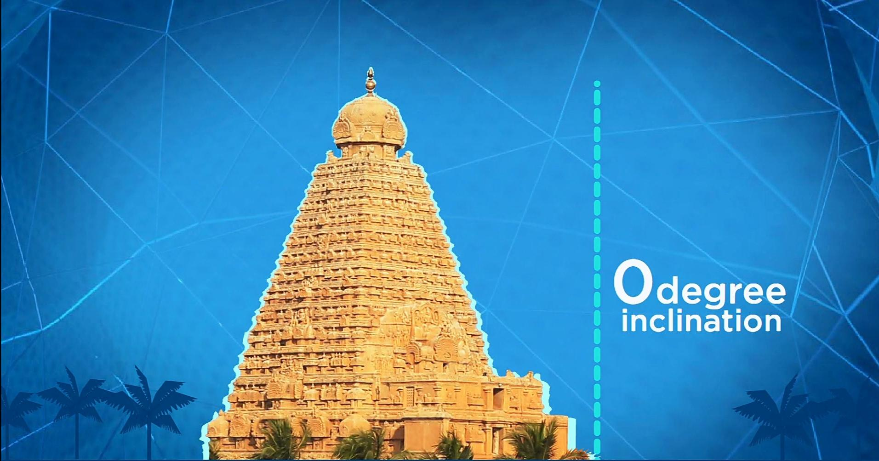
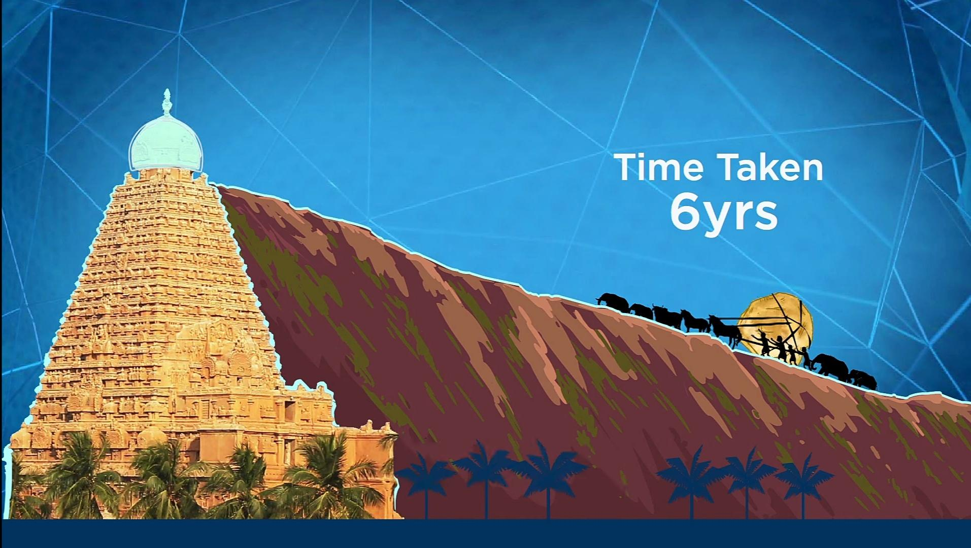
After these many years many ancient architectures are tilting like the leaning tower of Pisa and the Big Ben, London. But even after 1000 years Brihadeeswara Temple is absolutely straight. This is because of temple’s puzzle or interlock technique and the other reason behind it is the base of the temple is wide.
The stone placed on the top the temple weights about 81 tons. Which is carved out of a single rock. Weighing approximately 81000 Kg . Those days when they had no cranes, to lift this stone they made a ramp of 6km long. Elephants, horses, Buffalos and labourers together carried the stone to the top of the temple. This process takes around 6 years.

Slide 9
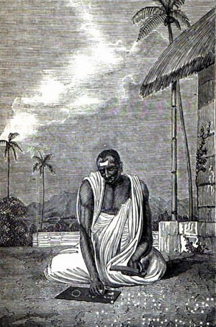
BRAHMAGUPTA QUADRATIC
FORMULA

Slide 10
The Indian mathematician Brahmagupta was the first to have write a form of the quadratic equation. He described it in the words below,
"To the absolute number multiplied by four times the [coefficient of the] square, add the square of the [coefficient of the] middle term; the square root of the same, less the [coefficient of the] middle term, being divided by twice the [coefficient of the] square is the value."

Slide 11
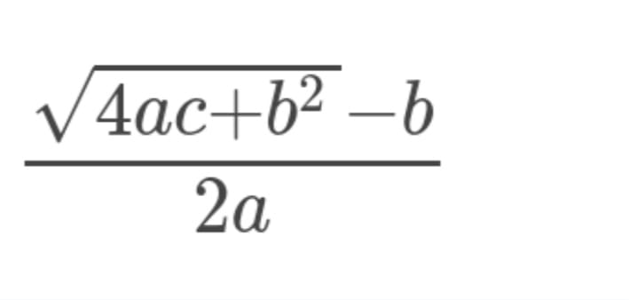
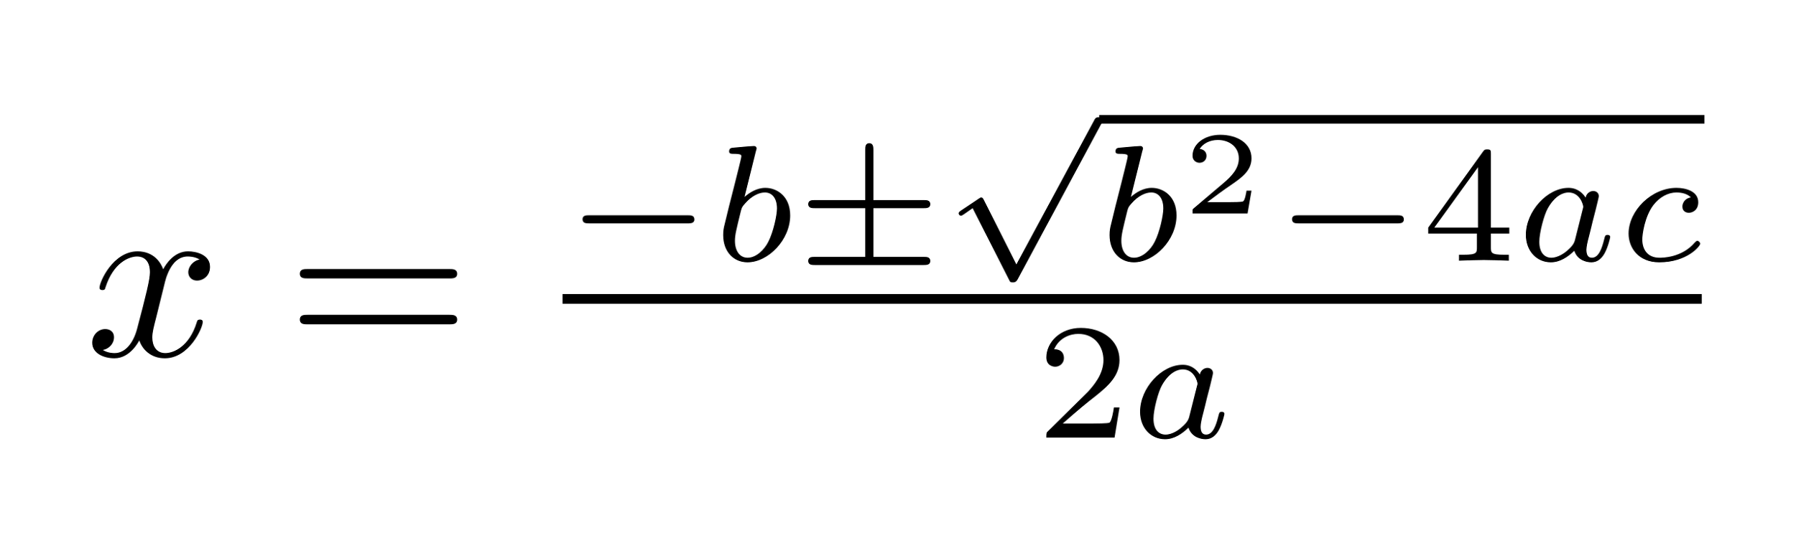
A mathematical interpretation of these words gives:
After some further development, the present day quadratic formula was discovered i.e.

Slide 12
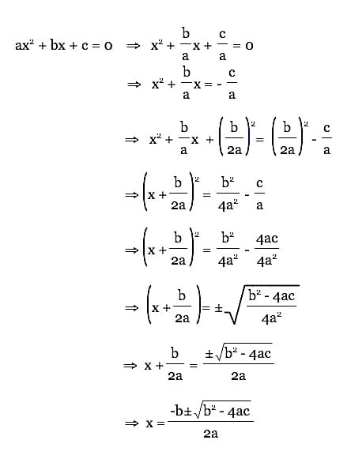

Slide 13
THANK
YOU

